Slide 1

Vaping Advocacy and Education Project Inc.
The Facts in Five Minutes
Notes:
This is a presentation to teach the basic facts about vaping in 5 minutes.
Further information can be found in “Vaping (Electronic Cigarette Use) the Truth” paper for download at VAEPworld.com

Slide 2


Tobacco Epidemic
A person dies every 6 seconds from smoking
Notes:
Social cost of tobacco use to Canadians $10 billion more than what is collected in tobacco taxes
37,000 Canadians die every year from smoking and approximately 1.1 million suffer with smoking-related diseases
This is 100% preventable!!

Slide 3
Why are cigarettes so addictive?
Nicotine addiction
Tobacco additives
Ritualistic behaviour
Cigarettes are up to 3 times more addictive
than just nicotine!
Notes:
52% try to quit every year but only 5% achieve long term cessation
Smoking is so addictive because
Nicotine is an addictive mild stimulant
Chemicals are added to make cigarettes MUCH more addictive than just nicotine
The ritualistic behaviour of bringing a smoke to the mouth, tasting the drag, sensations in the throat and lungs on a big inhale and a visible exhale. This behaviour is coupled with a hard hit of nicotine to the brain and is repeated 240 times a day for a pack-a-day smoker; that’s 87,600 times a year.
This is why smoking one of the hardest things to quit

Slide 4

Ingredients
Non-toxic vapour
Toxic smoke
4 typical ingredients
Propylene glycol
Vegetable Glycerin
Nicotine
Flavour
600+ ingredients
Ammonium salts
Menthol
Eucalyptol
Theobromine
Lactones
Acetaldehyde
Notes:
There are typically 4 ingredients in eliquid:
PG is used as a base in fog machines, injectable medications, hospital air sanitizers
VG is an organic benign liquid
Pharmaceutical grade nicotine comes in controlled doses to wean down & off
Flavour
Tobacco cigarettes, contain up to 600 ingredients many of which, I can’t pronounce
Just a few of the chemicals added to tobacco to enhance nicotine delivery and effects are
Ammonium salts which make more nicotine enter the bloodstream
Menthol numbs the lungs to suppress coughing
Eucalyptol & theobromine open the passageway to the lungs to get more smoke in
Lactones reduce the body’s ability to get rid of nicotine
Acetaldehyde acts as an antidepressant

Slide 5
Smoking cessation
Smokers wanting to quit:
6% quit with nicotine patches
Smokers NOT wanting to quit
21% quit with vaporizers
Dual users had a
40% smoking reduction!
Notes:
Millions of smokers have quit smoking by using vaporizers
In controlled clinical trials, at six months:
21% of smokers quit by using vaporizers vs 6% with patches. Dual users (vaping and smoking) had a 40% reduction in smoking.

Slide 6
Public Vaping Bans
Prevent maintaining nicotine levels
Deceivingly implies vaping is hazardous
Forces smokers trying to quit to stand amongst people smoking
Notes:
Public vaping bans don’t encourage smokers to switch to vaping.
To reduce smoking cravings, the person has to vape to keep the nicotine levels in the blood high enough. Just as with a nicotine patch wouldn’t be effective if they had to take it off every time they were in public.
Vaping bans would deceivingly imply that vaping is hazardous so smokers would be less likely to try vaping and it would lower social support
Forcing someone who is trying to quit smoking to stand outside with people smoking greatly increases the chance of relapse!

Slide 7
Conclusion
Responsible government
supports vaping in public
Smoking
  Highly addictive
  Causes disease and death
Vaping
  95% less harmful
  Effective method of reducing or quitting smoking
Notes:
We have an ethical obligation to support every person’s right to utilize harm reduction
Especially for smoking which is the #1 most preventable cause of disease and death in Canada/US.

Slide 8
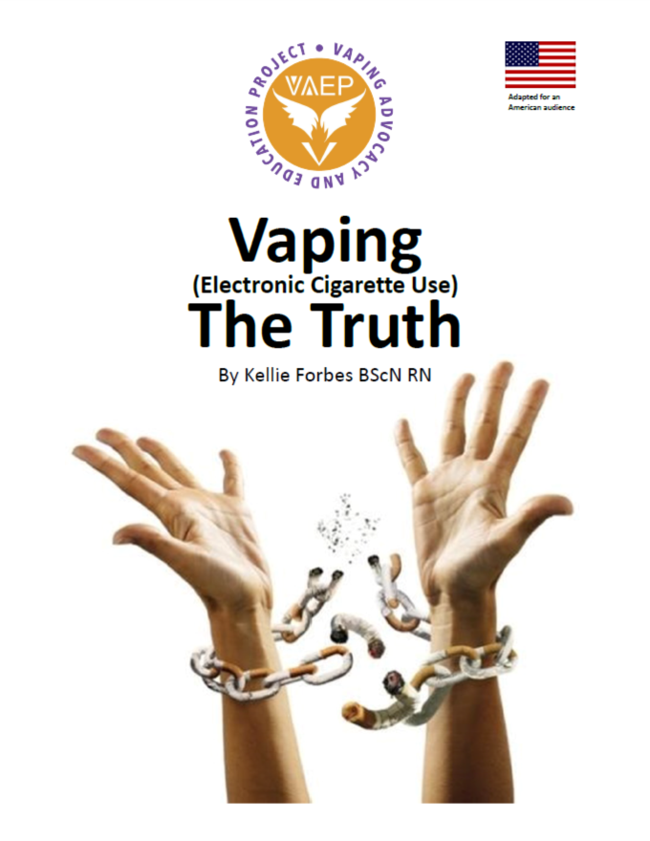
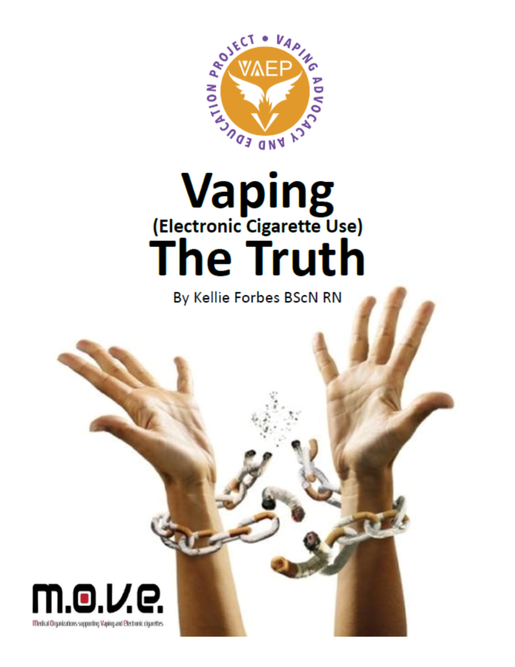

Reference
‘Vaping (electronic cigarette use) the Truth’ comes in
Canadian and American
versions
Free at
VAEPworld.com
Notes:
Thank you. Any questions?

Slide 9
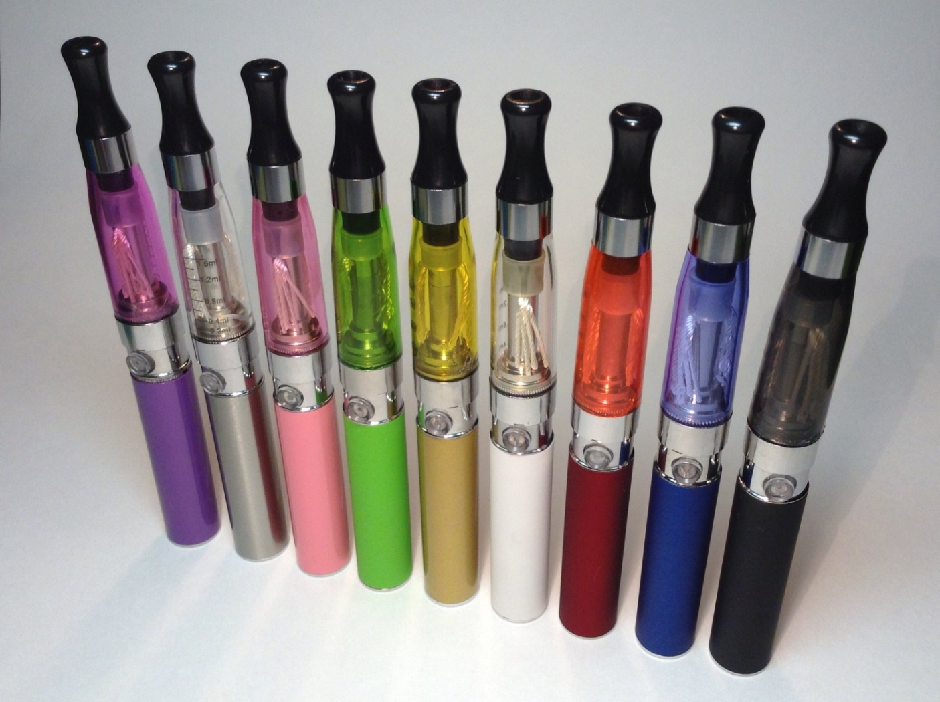
How vaporizers work
Heating a liquid to a gas…
NOTHING is burning and making smoke
Notes:
Rechargeable battery powers a heating element called a ‘coil’.
Wicks draw fluid to the coil where it is heated into a vapour.

Slide 10
Evolving technology
1st generation: cig-a-like & cartomizer
2nd generation: tank system
Notes:
Vaping technology and market has been completely consumer driven by smokers wanting to quit.
Not one dime of tax dollars have contributed to the promotion of this revolutionary harm reduction device.
1st generation: the cig-a-like
Same quit rate as patches (6%) because of poor nicotine delivery
2nd generation: tank systems
More than triples quit rate of patches (21%)
Better nicotine delivery and longer battery life
More variety of styles and evolving technology
3rd generation:
Tank systems that the user can change settings such as wattage.

Slide 11
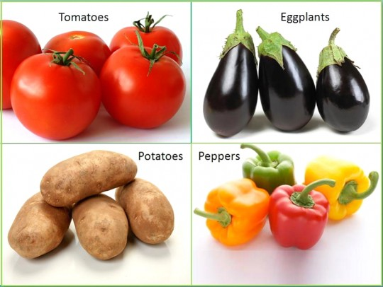
Nicotine
Nicotine is found in food
Notes:
Nicotine is a mildly addictive stimulant
stimulates cognitive function
elevates mood
increases energy
Nicotine is found in nightshade plants such as tomatoes and potatoes.
It is one of the safest medicines and has been studied for treating neurological disorders.
Follow-ups with those subjects found that none were addiction to nicotine after the studies.
As with any drug, such as Tylenol, the amount determines if it is an ineffective, therapeutic, toxic or lethal dose

Slide 12
Level of addiction
Nicotine is only one of over 6000 chemicals in cigarette smoke.
Notes:
A study was done with people addicted to different delivery systems of nicotine (gum, chew & cigarettes)
This graph shows their quit rates 6 months later. Those who were addicted to just nicotine (gum) were more than 3 times more likely to quit than smokers indicating cigarettes are more addictive than nicotine on its own.
We know that nicotine is just one of over 6000 chemicals produced when chemically laden cigarette tobacco is burned. Some of these chemicals enhance the delivery and effects of nicotine. Some are addictive themselves such as acetaldehyde which acts as an antidepressant.

Slide 13
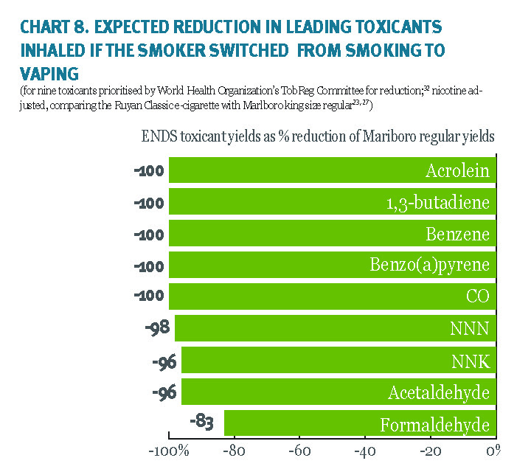
Harm reduction
Vaping is a SIGNIFICANT reduction in harm
Notes:
This is a graph of the WHO’s list of the top 9 toxins in cigarette smoke.
The bars show the amount of reduction of theses substances in vapor compared to cigarette smoke.
As you can see 5 of these are completely eliminated at 100% reduction. Then 98, 96, 96 and 83% reduction
Over 9000 observations of vapour were compared to Workplace Exposure Standards (WES). All of the 9000 observations were less than 1% of WES levels with the exception of 2 which were less than 5%.

Slide 14
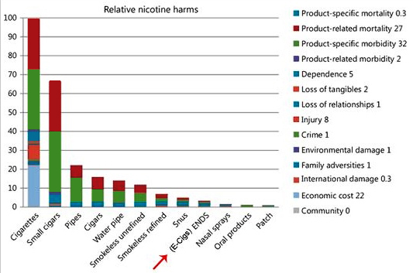
95% safer
Vaping is 5% the risk of smoking
Notes:
This is a graph from a study that applied the MCDA process which assesses 14 harm criteria.
12 sources of nicotine were compared.
Cigarettes are rated at 100 out of 100. While vaping was rated at 5 out of 100
This study indicates that vaping is 95% safer than smoking.

Slide 15
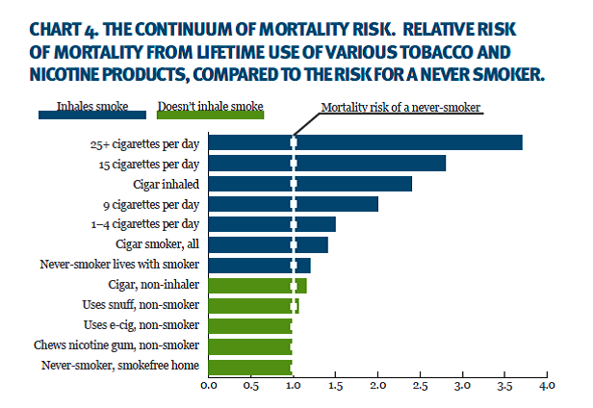
Risk of death same as a non-smoker
Notes:
This chart illustrates that vaping has the same risk of premature death as non-smoker
The toxins in cigarette smoke cause disease such as 85% of lung cancer & 87% of COPD
Vapers with chronic disease reported a reduction in disease symptoms
40% Diabetes
42% High cholesterol
65% asthma
54% heart disease
76% COPD
18% taking medication for lung disease no longer needed to
In one study with asthmatic smokers, their was a reversal of lung damage when they reduced or quit smoking by vaping.

Slide 16
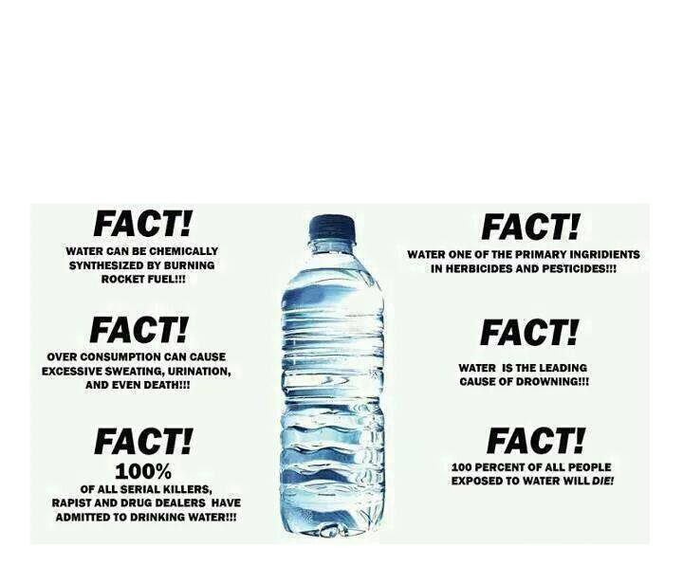
Misinformation
How much of the substance
How that effects human health
Notes:
This is an example of misinformation (read slide)
“Water is in antifreeze” does that make water dangerous? We have heard that PG (the base ingredient in eliquid) is in antifreeze. It is interesting to note that PG was added to antifreeze to replace a toxic substance that was killing family pets.
We hear a lot of misinformation about vaping such as reports there are harmful substances in eliquid. But if the article does not tell you how much of that substance or how it effects health then they are being misleading and inflammatory.
For instance, we walk down city streets with traffic, but are not concerned with the toxins in vehicle exhaust. The reason is because the toxins are in too small a quantity to cause harm when outdoors. However, if you are in an enclosed space with a running vehicle the toxin levels would become high enough to cause harm.
All toxins detected in eliquid and vapor under normal operating conditions have been well within safe ranges.

Slide 17
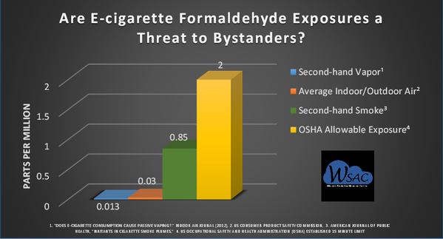
Formaldehyde
There is less formaldehyde in vapor than indoor air
Notes:
The bars you see are levels of formaldehyde:
Yellow bar is OSHA allowable exposure levels at 2 parts per million
Green is second hand smoke at 0.85 parts per million
Red is indoor air at 0.03 parts per million
And the blue is vapor that is 0.013 parts per million
Vapour contains less than 1% of formaldehyde safety levels and 1/3 less than normal room air.

Slide 18
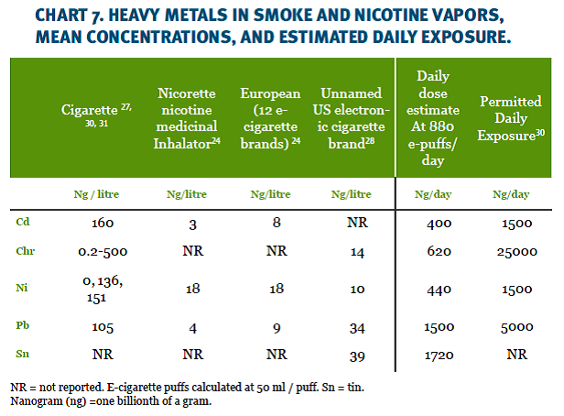
Heavy metals
Heavy metals in vapour are too low to harm
Notes:
This chart compares the heavy metals cadmium, chromium, nickel, lead and tin content in cigarette smoke, to nicotine inhalers and to vaporizers
There is a significant reduction in heavy metals using both inhalers and vaporizers
The amount of heavy metals in vapour is the same as what’s in nicotine inhalers.
These levels are far too low to cause any harm to the vapor or bystander.

Slide 19
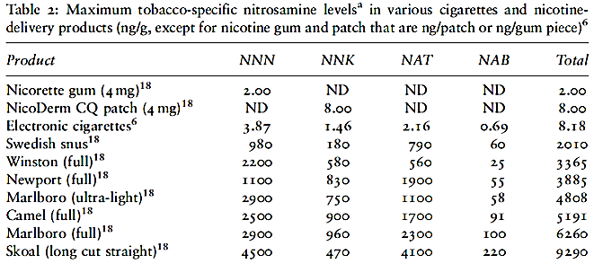
Carcinogens
Smoke has 3365ng but vapour has 8ng
Notes:
Tobacco Specific Nitrosamines (TSN) are carcinogens, they cause cancer (title row, NNN etc)
This chart shows the levels of TSN content in (starting from the top row)
nicotine gum, patch, vapour snus and at the bottom, cigarette smoke
The cigarette smoke contained 3365ng of TSN compared to vapour and the patch both at 8ng

Slide 20

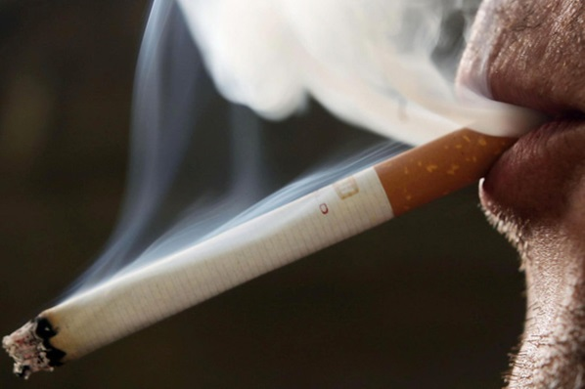
‘Normalizing’ smoking
Vaping does NOT…
Smell
Look
Operate
Pollute
Addict
Harm
…like smoking!
Notes:
Vaping eliminates stink of cigarette smoke
A vaporizer does not look like a cigarette
Vapour is evaporated liquid, nothing is burning
Vapour flavours taste way better than toxic smoke
Vaping is generally cheaper than smoking
Vapour does not harm bystanders
Pharmaceutical grade nicotine in vapour is less addictive than cigarette smoke
And most importantly vaping is 5% the risk of smoking
Vaping normalizes quitting smoking

Slide 21

Banning flavours
Appealing flavours help smokers switch
Notes:
4618 vapers surveyed:
91% quit smoking using a vaporizer
Rated flavour as 4 out of 5 in importance
49% said they would have an increased smoking cravings if flavours were banned
40% said they would have been less likely to quit if flavours weren’t available
2/3 switch flavours daily because taste gets blunt, so variety is important
70% vape fruit, 61% vape sweet such as candy flavours
Tobacco flavours used initially and more frequently in dual users
Flavour is a significant aspect of switching to vaping!
Survey with teens:
no difference in desire to try vaping with flavours than without
74% of the teens that smoked were interested in trying vaping vs only 18% of non-smoking teens
Its important to note that 43% of grade 12 students have tried smoking

Slide 22
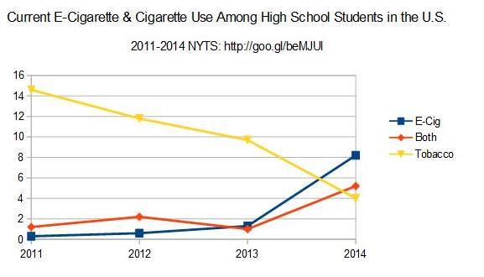
Gateway Theory
As vaping rates are increasing, smoking rates are decreasing faster than ever
Notes:
In the UK from 2007-2011: smoking quit rates dropped (6.7% to 4.6%)
2012 700,000 smokers switched to vaping and the quit rate jumped to 6.2%
2014 2.1 million vapers in the UK and the quit rate jumped again to 7.5%
99% teens who’s first nicotine source was an EC don’t smoke
10-21% teens who’s first nicotine source was smoke became daily smokers
Gateway theory is nonsense!
Pleasant flavours to gross tasting smoke
100 fold worse for your health
More expensive to smoke
Smoking makes you stink
Smoking is more addictive
Normal teens expeariment adult taboos. The question is can we reduce the harm in normal teenage behaviour?

Slide 23
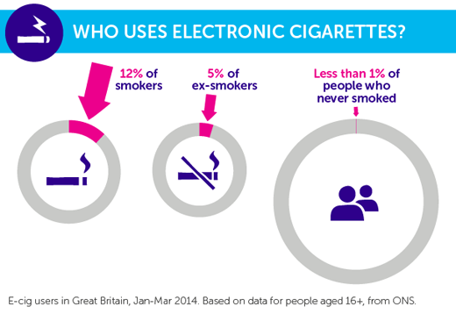
Who are vaping?
0.14% of vapers never smoked
Notes:
ONLY 0.14% of vapers never smoked.
Vaping is attractive to current smokers because it uniquely mimics much of the ritualistic behavour of smoking as well as the internal sensations.
Lets look at the results of 25,000 vapers surveyed:
Tried to quit smoking an average 9 times
2/3 tried nicotine replacement therapies unsuccessfully
19% were dual users and had a 40% reduction in smoking
90% claimed their health improved
93% claimed vaping is less addictive
64% reported still having a smoking experience with reduced health risk

Slide 24
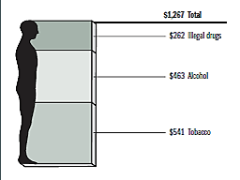
Tobacco Harm Reduction
Smoking is everyone’s problem
Smoking costs
$20 billion
a year!
Notes:
The Social Cost of Substance Abuse in Canada Survey estimated that smoking cost to the taxpayer in Canada per year was $17 Billion. That’s $55million every day (survey was in 2003 so higher now)
Higher cost than alcohol and illegal drugs
But federal and provincial tobacco taxes collected in 2013 were $7 billion
Smoking is everyone’s problem! If smokers switch to a less harmful alternative, the social cost will be reduced

